Slide 1
ECSC 325.200 Web Server Administration
Spring 2025 – Week 6-1 – February 18th, 2025
Server configs and Virtual Hosts
Prof. Jason Patalon

Slide 2
Objectives
Attendance and administrative
Semester Grades Review
SSH Proxy Connection Review
PHP Installation
MariaDB Installation
Test website configurations
Virtual hosts
Ecsc325-1##, phpMyAdmin, temperature graphs, Megastuff, Ultrastuff, Wordpress…

Slide 3
Weekly Info
A dream written down with a date becomes a goal. A goal broken down into steps becomes a plan. A plan backed by action makes your dreams come true. – Greg S. Reid
Attendance
Good of the class
Assignment 5 due tomorrow Feb 19th!
Assignments 6 & 7 due Feb 26th!
Midterm next week – Feb 27th!
Final – Tuesday April 29th!

Slide 4
Recap and Review
The next few weeks…
Web servers & forms
Database services
E-mail services
File transfer services
Security and authentication
Monitoring and performance tuning
Corrections, updates, etc.
Review of previous assignments
Assignment reviews…
Questions from previous classes?
Etcetera
Clouds?!

Slide 5
Web Browser SOCKS Proxy Config
Firefox Example
Extremely easy to set, others more difficult
Open SSH tunnel with dynamic port forwarding to jpatalon.cs.edinboro.edu:54321
Ex: ssh –D 55555 cs_student@jpatalon.cs.edinboro.edu –p 54321
Connect on port 54321 (-p)
SOCKS Dynamic Proxy on port 55555 (-D)
Password info in credentials file in D2L!
Launch Firefox!
Configure the proxy settings in Firefox…

Slide 6
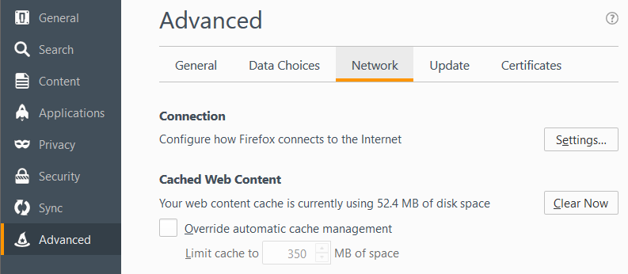
Web Browser SOCKS Proxy Config
Exact steps may differ depending on version
Options
Advanced
Network Tab
Settings…
Older Firefox version…

Slide 7
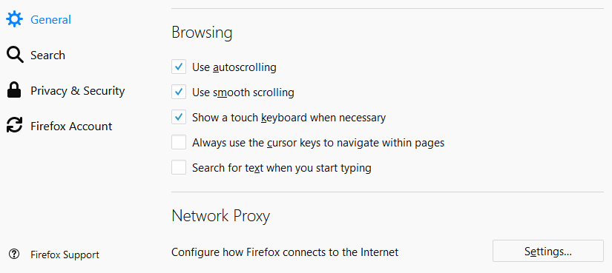
Web Browser SOCKS Proxy Config
Exact steps may differ depending on version
Options
General
Network Proxy
All the way at the bottom
Settings…
Firefox v59.0.1+

Slide 8
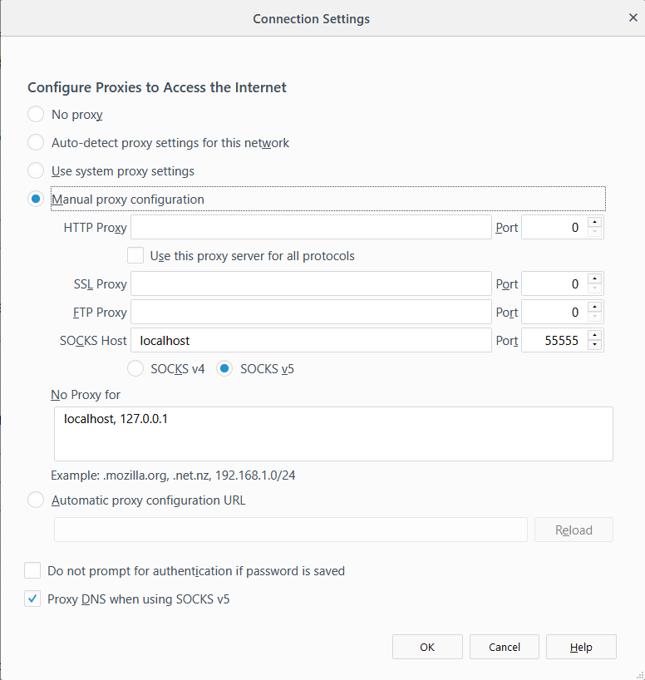
Web Browser SOCKS Proxy Config
Exact steps may differ depending on version…
Options
Advanced
Network Tab
Settings…
Manual Proxy Configuration
SOCKS Host: localhost
Port: 55555
SOCKS v5
No proxy for:
localhost, 127.0.0.1
Proxy DNS when using SOCKS v5

Slide 9
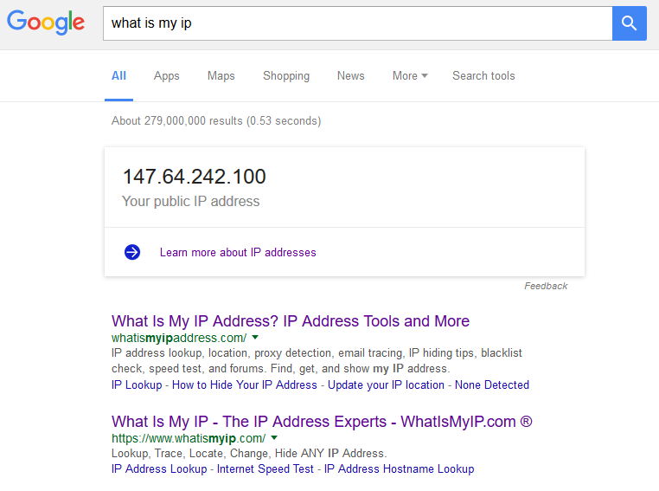
Web Browser SOCKS Proxy Config
Test by opening a web page, and visit a website that will tell you your IP
http://whatismyip.com
Type in to google “What is my ip”
Multiple servers with multiple ports
Open multiple connections on different ports
Switch ports to quickly switch proxy endpoint
Compare to same search in a different browser that is not configured for proxying
Firefox should give a different result than Chrome or Interner Explorer, since Firefox is configured to use the SSH SOCKS proxy and the other web browsers are not.
EUP outbound traffic is NAT’d, so you might not see a different IP address anymore!

Slide 10
Server Configuration
Install PHP
dnf install php
New php-fpm service is installed!
Main PHP configuration file located at /etc/php.ini
PHP adds a configuration file to Apache
/etc/httpd/conf.modules.d/10-php.conf
Apache needs restarted to pick up new config file!
systemctl restart httpd.service
Create a new document /var/www/html/index.php
<?php
phpinfo();
?>
Open new php web page:
VM’s: http://ecsc325-1##.cs.edinboro.edu/index.php
php-fpm service!

Slide 11
Server Configuration
Change Default Index Page
Edit apache configuration file /etc/httpd/conf/httpd.conf
Find the DirectoryIndex setting, change to below:
DirectoryIndex index.php index.html
Apache needs restarted (again) to pick up changed config file
systemctl restart httpd.service
Disable phpinfo?!
Edit /etc/php.ini file, add phpinfo to disable_functions
disable_functions = phpinfo
Restart php-fpm service
systemctl restart php-fpm
Refresh Website
Re-enable, restart php-fpm, and refresh page again
Phpinfo can be considered a security risk, but we want it enabled for now!

Slide 12
Server Configuration
MariaDB – A fork of MySQL, intended as a drop in replacement
Install MariaDB
dnf install mariadb-server
Start and enable MariaDB
systemctl start mariadb.service
systemctl enable mariadb.service
Secure the MariaDB Service
mysql_secure_installation
Set root password, remove anonymous users, disallow root remote login, remove test database, reload privileges.
Log in to MariaDB
mysql –u root –p
help;
exit;

Slide 13
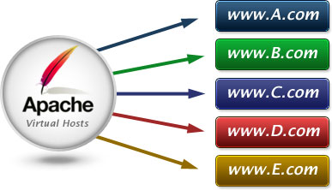
Virtual Host Configurations
Virtual hosts have been created for each student
31## Virtual hosts use a CNAME DNS records to point to student’s records
3125.megastuff.biz canonical name = ecsc325-125.cs.edinboro.edu.
1## Virtual hosts use A record to IP address
Name: 125.megastuff.biz
Address: 147.64.243.125
VM’s: http://1##.megastuff.biz and http://31##.megastuff.biz
NUMBER is 01-25 (ex: 101-125 and 3101-3125)
Ex: http://125.megastuff.biz and http://3125.megastuff.biz points to http://ecsc325-125.cs.edinboro.edu
Make note of your virtual hosts!
Remember, direct VM connections only work on CS network!
Must connect through VPN!

Slide 14
Virtual Host Configurations
Before creating virtual hosts, we need to explicitly set our default host!
Create the file /etc/httpd/conf.d/00-localhost.conf
<VirtualHost *:80>
ServerName ecsc325-1##.cs.edinboro.edu
ServerAlias 147.64.243.1##
DocumentRoot "/var/www/html"
</VirtualHost>
This will ensure that traffic to the default hostname or server IP go to the default location
Restart apache to apply new configuration file
We shouldn’t notice anything different on our website yet…
http://ecsc325-1##.cs.edinboro.edu
Replace the ## with your 2-digit number!

Slide 15
Virtual Host Configurations
Create the http://31##.megastuff.biz virtual host
Create the file /etc/httpd/conf.d/31##.conf
<VirtualHost *:80>
ServerName 31##.megastuff.biz
DocumentRoot "/var/www/31##"
</VirtualHost>
Create the 31## folder mentioned above!
mkdir /var/www/31##
Create an index page in for the new virtual host!
echo Hello Megastuff > /var/www/31##/index.html
Restart Apache and check if it worked!
Visit http://31##.megastuff.biz
Validate our old site still works – should display phpinfo!
Visit: http://ecsc325-1##.cs.edinboro.edu
Visit: http://147.64.243.1##
Replace the ## with your 2-digit number!

Slide 16
Virtual Host Configurations
Create the http://31##.megastuff.biz:81 virtual host
Create the file /etc/httpd/conf.d/31##p81.conf
<VirtualHost *:81>
ServerName 31##.megastuff.biz
DocumentRoot "/var/www/31##p81"
</VirtualHost>
Create the 31## folder mentioned above!
mkdir /var/www/31##p81
Create an index page in for the new virtual host!
echo Hey there port 81 > /var/www/31##p81/index.html
Have to add a statement to allow listening on port 81!
Details on the next slide! Yay!
Don’t forget to restart apache after changing .conf files!
systemctl restart httpd
Replace the ## with your 2-digit number!

Slide 17
Virtual Host Configurations
Create the http://31##.megastuff.biz:81 virtual host
We have to also edit our main httpd.conf file to listen on port 81!
Edit the file /etc/httpd/conf/httpd.conf and add this line below the “Listen 80” line:
Listen 81
It should look like this when done:
Restart Apache and check if it worked!
Visit http://31##.megastuff.biz:81
Validate our old sites still work – should still display phpinfo!
Visit: http://ecsc325-1##.cs.edinboro.edu
Visit: http://147.64.243.1##
Replace the ## with your 2-digit number!

Slide 18
Virtual Host Configurations
Create new Ultra Modern webpage from template on virtual host
Install unzip package to provide unzip functionality!
dnf provides *bin/unzip
dnf -y install unzip
Download template and move to www directory
mkdir -p /tmp/ultra_template
cd /tmp/ultra_template
wget https://jpatalon.cs.edinboro.edu/ecsc325/classfiles/ultra_modern.zip
unzip -e ultra_modern.zip
ls
mv web/ /var/www/
cd /var/www/web
pwd
ls -lah /var/www/
Notes:
Ultra Modern Template Website

Slide 19
Virtual Host Configurations
Create new webpage from template on virtual host
Create new virtual host config file at /etc/httpd/conf.d/web.conf
<VirtualHost *:80>
DocumentRoot "/var/www/web"
# Note server name below is 3 digits
ServerName 1##.ultrastuff.net
</VirtualHost>
Test that it all worked!
Restart apache
systemctl restart httpd.service
Visit websites and verify
http://1##.ultrastuff.net
Notes:
Ultra Modern Template Website

Slide 20
Virtual Host Configurations
Create new WordPress site on virtual host
Install Prerequisites
dnf -y install php-mysqlnd
systemctl restart httpd.service
Create Database and User
mysql -u root –p
Log in with your root mysql password!
create database wordpressdb;
grant all privileges ON wordpressdb.* TO "wordpressuser"@"localhost" identified by "wordpresspass";
flush privileges;
show databases;
select user,host,password from mysql.user;
exit;
Notes:
WordPress Website

Slide 21
Virtual Host Configurations
Create new WordPress site on virtual host
Install tar!
dnf -y install tar
Download package
cd /tmp
wget https://wordpress.org/latest.tar.gz -O /tmp/latest.tar.gz
tar zxvf /tmp/latest.tar.gz
ls
mv /tmp/wordpress/ /var/www/
Check the permissions! We should secure our wordpress directory!
ls -lah /var/www
chown -R root:apache /var/www/wordpress
chmod -R ug+rwX,o-rwx /var/www/wordpress
ls -lah /var/www
ls -lah /var/www/wordpress
Notes:
WordPress Website

Slide 22
Virtual Host Configurations
Create new WordPress site on virtual host
Create new virtual host config file at /etc/httpd/conf.d/wordpress.conf
<VirtualHost *:80>
DocumentRoot "/var/www/wordpress"
# Note server name below is 4 digits
ServerName 31##.ultrastuff.net
</VirtualHost>
Test that it all worked!
Restart apache
systemctl restart httpd.service
Visit websites and verify
http://31##.ultrastuff.net
Should get WordPress config page!
Not working? Something else wrong? Check the logs!
/var/log/httpd/
Notes:
WordPress Website

Slide 23
Update PHP!
Our PHP Installation is pretty old…
This is typical of RedHat based distros
They standardize on a specific version (ex: 5.4)
They “back-port” fixes, features, and other updates as they see necessary
Sometimes this means the default version of a package is older that what we need!
RedHat and CentOS have a selection of additional software repositories
Let’s install two additional software repositories, enable the remi-php56 repo, and update!
dnf -y install https://dl.fedoraproject.org/pub/epel/epel-release-latest-7.noarch.rpm
dnf -y install http://rpms.remirepo.net/enterprise/remi-release-7.rpm
dnf -y install dnf-utils
dnf-config-manager --enable remi-php56
dnf -y update
Restart Apache!
systemctl restart httpd
Only for RHEL7/CentOS7!

Slide 24
Virtual Host Configurations
Create new WordPress site on virtual host
Configure WordPress Database
Database Name: wordpressdb
Username: wordpressuser
Password: wordpresspass
Database Host: localhost
Prefix: wp_
Configure WordPress Website
Site Title: Your Name
Username: Your wordpress user
Password: Your wordpress password
Email: Your university email
Discourage search engines from indexing site
Doesn’t really matter, search engines can’t access our sites anyways!
Notes:
WordPress Website

Slide 25
Virtual Host Configurations
Replace the ## with your 2 digit number!!!
Create new WordPress site on virtual host
Allow for updates without FTP
Edit file: /var/www/wordpress/wp-config.php
Add to end of file:
define('FS_METHOD','direct');
Restart apache
systemctl restart httpd.service
Update or Reinstall WordPress!
Proceed to login page
http://31##.ultrastuff.biz/wp-login.php
Check for updates
Update yo site!
Re-install if there are no updates!
This makes sure the process will work!
Notes:
WordPress Website

Slide 26
Virtual Host Configurations
Install phpMyAdmin
Install Prerequisites
A new dnf repository has appeared! Extra Packages for Enterprise Linux
Provides additional packages that are not maintained by official OS channels
dnf config-manager --set-enabled crb
dnf -y install https://dl.fedoraproject.org/pub/epel/epel{,-next}-release-latest-9.noarch.rpm
dnf -y install phpmyadmin
Edit /etc/httpd/conf.d/phpMyAdmin.conf
By default, phpMyAdmin only allows access from the localhost
This is a security feature; we really should proxy our web connection…
Change the 2 lines that say "Require local" to below:
Require ip 127.0.0.1 0.0.0.0/0.0.0.0 # 2 of these lines
Restart Apache!
systemctl restart httpd.service
Optionally allow from 147.64.0.0/255.255.0.0
Notes:
phpMyAdmin Website

Slide 27
Virtual Host Configurations
Replace the ## with your 2 digit number!!!
Install phpMyAdmin
Visit website:
http://1##.ultrastuff.net/phpmyadmin
http://1##.megastuff.biz/phpmyadmin
http://31##.megastuff.biz/phpmyadmin
http://ecsc325-1##.cs.edinboro.edu/phpmyadmin
http://147.64.243.1##/phpmyadmin
Notice you can get to phpMyAdmin from any domain!
This is not really desired behavior…
We’re going to change this in a minute…
Use your MariaDB user credentials to log in!
Just like logging in to mysql from the command line.
Notes:
phpMyAdmin Website

Slide 28
Virtual Host Configurations
Install phpMyAdmin
Edit /etc/httpd/conf.d/phpMyAdmin.conf
Add to beginning of file (immediately before first line starting with Alias):
<VirtualHost *:80>
DocumentRoot "/var/www/html"
ServerName ecsc325-1##.cs.edinboro.edu
ServerAlias ecsc325-1##
ServerAlias 147.64.243.1##
ServerAlias localhost
ServerAlias 127.0.0.1
ServerAlias ::1
Add to the end of file:
</VirtualHost>
This forces everything in phpMyAdmin.conf to only be available within the ecsc325-1## FQDN, IP, or localhost addresses!
Notes:
phpMyAdmin Website

Slide 29
Virtual Host Configurations
Install phpMyAdmin
Delete old localhost virtualhost configuration file:
rm -rf /etc/httpd/conf.d/00-localhost.conf
Restart Apache@!
systemctl restart httpd.service
Visit website:
VM's:
http://1##.ultrastuff.net/phpmyadmin
http://1##.megastuff.biz/phpmyadmin
http://31##.megastuff.biz/phpmyadmin
The three above should no longer work, the two below should!
http://ecsc325-1##.cs.edinboro.edu/phpmyadmin
http://147.64.243.1##/phpmyadmin
The old 00-localhost.conf file conflicts with our phpMyAdmin.conf file configuration on the previous slide!
Notes:
phpMyAdmin Website

Slide 30
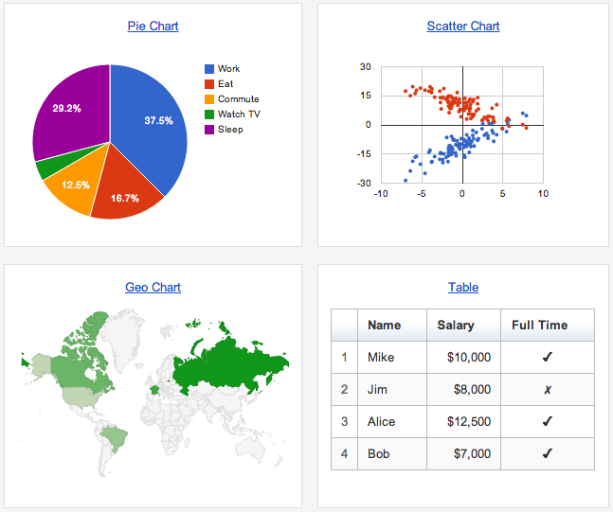
Google Graph Webpage
Create database in MariaDB
Log in to MariaDB (mysql)
Create new database
Create new user and grant necessary privileges
Flush (refresh) privileges
Create new table in database
Import data
Create website
Create new subfolder for temperature data
Download necessary webpage files to new location
Validate any necessary settings
Test!

Slide 31
Virtual Host Configurations
Download SQL data (that’s a capital O!)
cd /tmp; curl -O https://jpatalon.cs.edinboro.edu/ecsc325/classfiles/temperature_data.sql
Create new database, user, and import SQL data
mysql -u root –p
create database temperature;
grant all privileges on temperature.* to 'temperature'@'localhost' identified by "temperaturepass";
CREATE TABLE IF NOT EXISTS temperature.temp (ID MEDIUMINT NOT NULL AUTO_INCREMENT, Date DATE, Time TIME, Temperature FLOAT, Humidity FLOAT, Dewpoint FLOAT, PRIMARY KEY (ID)) ENGINE=InnoDB;
LOAD DATA LOCAL INFILE '/tmp/temperature_data.sql' INTO TABLE temperature.temp;
flush privileges;
exit;
Notes:
Google graph website

Slide 32
Virtual Host Configurations
We need a new 1##.megastuff.biz virtual host definition!
#File /etc/httpd/conf.d/1##.megastuff.conf
<VirtualHost *:80>
ServerName 1##.megastuff.biz
DocumentRoot "/var/www/1##"
</VirtualHost>
Dont forget to restart Apache!
systemctl restart httpd
Replace the ## with your 2 digit number!!!

Slide 33
Virtual Host Configurations
Create new megastuff temperature directory and download necessary web pages
mkdir -p /var/www/1##/temp/
cd /var/www/1##/temp/
wget https://jpatalon.cs.edinboro.edu/ecsc325/classfiles/jquery.min.js
wget https://jpatalon.cs.edinboro.edu/ecsc325/classfiles/loader.js
wget https://jpatalon.cs.edinboro.edu/ecsc325/classfiles/temp.php
wget https://jpatalon.cs.edinboro.edu/ecsc325/classfiles/getData
mv getData getData.php
Check
http://1##.megastuff.biz/temp/temp.php
Page not loading?
Check the log files…
/var/log/httpd
Check the permissions!
Replace the ## with your 2 digit number!!!
Notes:
Google graph website

Slide 34
Virtual Hosts
http://ecsc325-1##.cs.edinboro.edu, http://147.64.243.1##
index.html: Hello ECSC-325 (Assignment 6)
index.php: PHP Info (Assignment 7)
http://ecsc325-1##.cs.edinboro.edu/phpmyadmin, http://147.64.243.1##/phpmyadmin
phyMyAdmin Website
http://1##.megastuff.biz/temp/temp.php
Temperature Graph Website
http://31##.megastuff.biz
index.html: Hello Megastuff Website
http://1##.ultrastuff.net
Ultra Modern Template Website
http://31##.ultrastuff.net
WordPress Website
http://##.megastuff.biz
TBD: Test page…
http://1##.megastuff.biz
TBD: Test page…
http://ecsc325-1##.cs.edinboro.edu/squirrelmail
TBD: Squirrelmail webmail
http://roundcube.##.megastuff.biz
TBD: Roundcube webmail
https://ecsc325-1##.cs.edinboro.edu/private
TBD: Private web site!
https://a13.##.megastuff.biz
TBD: Assignment 13 web site!
Replace the ## with your 2 digit number!!!

Slide 35
Configure
Install PHP and change default index file
phpinfo!
Install & Configure MariaDB
Localhost config file
31## megastuff config file
31##p81 megastuff config file
Virtual hosts
Ecsc325-1##, 31##.megastuff.biz, 31##.megastuff.biz:81
Update your system
Reboot
Assignment 7

Slide 36
Configure
Ultra Modern Website
Wordpress Website
EPEL Install
phpMyAdmin Install
Temperature graph website
Virtual hosts
Ecsc325-1##, phpMyAdmin, temperature graphs, Megastuff, Ultrastuff, Wordpress…
Update your system
Reboot
Assignment 8

Slide 37
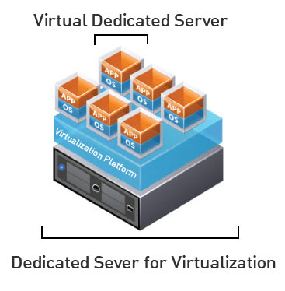
Virtual Machine Info
IP Address: 147.64.243.1## (01-25)
Hostname: ecsc325-1##.cs.edinboro.edu (01-25)
Alias: ##.megastuff.biz (01-25)
1##.megastuff.biz, 31##.megastuff.biz, 1##.ultrastuff.net, others?
Assignment 5 due tomorrow night, Assignment 6 & 7 next week!
Check script submissions and document uploads in D2L!
Accessing VM’s from off campus requires a connection to the CS VPN first, before opening a connection to your machine!
CS firewall prevents direct connections from other networks to our VM’s!
Once VPN is active: ssh user@ecsc325-1##.cs.edinboro.edu
math.cs.cdinboro.edu replaced with cs.edinboro.edu!
megastuff.online replaced with megastuff.biz!

Slide 38
ECSC 325.200 Web Server Administration
Spring 2025 – Week 6-2 – February 20th, 2025
Web Server Installations & Configurations
Prof. Jason Patalon

Slide 39
Objectives
IP Address Review
SSH Tunnels Review
Web Server Review
Ports
E-Mail Services
History of E-Mail
Understanding the E-Mail environment
E-Mail protocols
SMTP
IMAP
POP
E-Mail services installation
Configuration
Caveats
Web-Mail Installation
Squirrelmail
Roundcube
Next Week?!

Slide 40
Recap and Review
The next few weeks…
File transfer services
Security and authentication
Network Services
Monitoring and performance tuning
Review of previous assignments
Questions from previous classes?
Assignment 6 due next week!
Assignment 7 due next week!
Etcetera…

Slide 41
Remaining Semester Topics*
E-Mail Services
SMTP
POP
Postfix
Dovecot
SquirrelMail
Roundcube
File Transfer Services
FTP
SCP
RSync
Network Functions
Security
HTTP Authentication
HTTPS/SSL
Firewall
SELinux
Public Key Cryptography
Monitoring
Backups
Performance Tuning
Final Exam
* Exact topics may change
Clouds?!

Slide 42
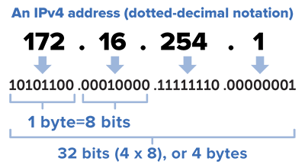
Finding IP address ranges
Consider the following CIDR mask: 147.64.242.128/23
Convert the IP address to binary
10010011.01000000.11110010.10000000
Convert netmask to binary
/23 = 255.255.254.0 = 11111111.11111111.11111110.00000000
Find the opposite binary netmask (the host portion - swap 1’s and 0’s)
11111111.11111111.11111110.00000000 → 00000000.00000000.00000001.11111111
Do bitwise AND on the binary IP and netmask to find starting IP:
IP Address: 10010011.01000000.11110010.10000000
Netmask: 11111111.11111111.11111110.00000000
Starting IP: 10010011.01000000.11110010.00000000
Convert new binary number to decimal
10010011.01000000.11110010.00000000 = 147.64.242.0
This is our starting IP address for the range!
The first IP in the range is reserved for the “Network ID”

Slide 43
Finding IP address ranges
Consider the following CIDR mask: 147.64.242.128/23
Convert the IP address to binary
10010011.01000000.11110010.10000000
Convert netmask to binary
/23 = 255.255.254.0 = 11111111.11111111.11111110.00000000
Find the opposite binary netmask (the host portion - swap 1’s and 0’s)
11111111.11111111.11111110.00000000 → 00000000.00000000.00000001.11111111
Do bitwise OR on the binary IP and opposite mask to find ending IP:
IP Address: 10010011.01000000.11110010.10000000
Netmask: 00000000.00000000.00000001.11111111
Ending IP: 10010011.01000000.11110011.11111111
Convert new binary number to decimal
10010011.01000000.11110010.00000000 = 147.64.243.255
This is our ending IP address for the range!
Put them together, we have 147.64.242.0 - 147.64.243.255
The last IP in the range is reserved for the “Broadcast address”

Slide 44
Broadcast Address
A network address which will broadcast packets to all hosts connected to that network
“The all-ones host”
The last IP address in an IP address range
EUP CS Department: 147.64.243.255/23
Only used by IPv4
IPv6 uses a “all-hosts multicast group” to accomplish similar functionality more efficiently
Data sent to a broadcast address isn’t routed
This keeps the broadcast packet within the local network
Necessary for DHCP
Often sent to IP address 255.255.255.255
Helper addresses used if DHCP server in a different subnet
Layer 2 broadcasts to MAC address FF:FF:FF:FF:FF:FF
Default Gateway
Next hop in transmitting my traffic be default

Slide 45
Understanding HTTP
As an example, in a web browser you type: http://jpatalon.ultrastuff.net
Web browser contacts DNS server to resolve IP address
That was a multi-step process…
DNS server returns IP address to browser
Web browser composes a request using IP address to port 80
Request will include host name
Web Browser assumes port 80 if no port is specified
Web server is configured to return index page if no page is specified
Web server may return directory listing if no index.html is found
GET / HTTP/1.1
Host: jpatalon.ultrastuff.net

Slide 46
Understanding HTTP
We can manually connect to a website and download webpages with telnet or a similar application
Telnet application would need installed on our VM’s
dnf provides */telnet
dnf install telnet
Open telnet connection with following command:
telnet hostname port
Ex: telnet jpatalon.ultrastuff.net 80
Watch for “Connected to” message indicating connection success
Connected to jpatalon.ultrastuff.net.
Escape character is '^]'.
Download the default webpage with the following commands:
GET / HTTP/1.1
Host: jpatalon.ultrastuff.net

Slide 47
HTTP Services
HTTP Described in RFC’s 7230-7235
HTTP versions 1.1 and 2.0 most widely used
HTTP port 80 / HTTPS port 443
Client connects to server, issues HTTP commands
GET, HEAD, POST, etc.
Filename to get, server hostname to use, port to use, additional details
Apache
Apache typically runs as user apache, group apache
The Apache user or group needs access to the files!
Additional modules provide additional functionality
SSL, authentication, CGI scripts, etc.
Apache configuration files
/etc/httpd – Main Apache directory
/etc/httpd/conf/httpd.conf – Main Apache configuration file
/etc/httpd/conf.d/ - Additional Apache configuration file directory

Slide 48
HTTP Example
Telnet to google.com on port 80
Install telnet with dnf!
dnf install telnet
telnet www.google.com 80
Issue a get command
GET / HTTP/1.1
User-Agent: Mozilla/4.0 (compatible; MSIE5.01; Windows NT)
Host: www.google.com
Accept-Language: en-us
Accept-Encoding: gzip, deflate
Connection: Keep-Alive
Enter a blank line to finish the command
Default search page HTML should be returned

Slide 49
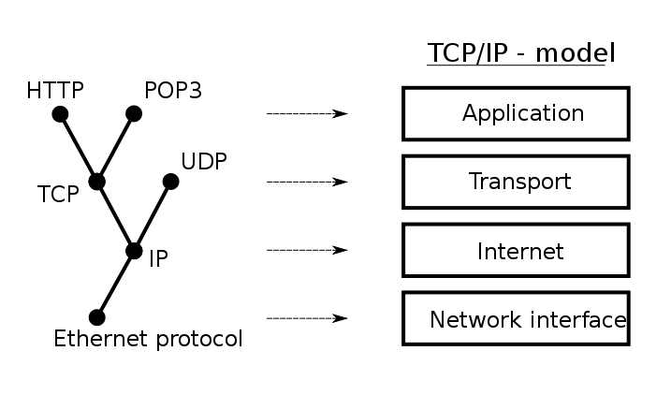
Ports
“An endpoint of communication in an operating system”
A port, combined with an IP and a protocol, creates communications session
Generally, different source and destination IP’s and ports are necessary
əˈfem(ə)rəl
Source
10.11.187.23 TCP port 57532
10.11.187.23:57532
Ephemeral port!
A short-lived port opened by the OS when a program requests a connection to a port, released after the conversation finishes. Generally in the range 49152 to 65535 (IANA Suggestion).
Sometimes in the range 1024-65535
Typically only root can open a port lower than 1024
Destination
192.168.53.79 TCP port 80
192.168.53.79:80
Defined service ports
Notes:
By Jsoon eu (talk) - I (Jsoon eu (talk)) created this work entirely by myself., CC BY-SA 3.0, https://en.wikipedia.org/w/index.php?curid=29962617

Slide 50
Ports
“An endpoint of communication in an operating system”
A port, combined with an IP and a protocol, creates communications session
Generally, different source and destination IP’s and ports are necessary
session
Multiple services cannot use the same port & protocol at the same time!
TCP and UDP ports are different, so one application can listen on TCP port 80, and another on UDP port 80.
Data is returned on the ephemeral port
NAT will maintain this connection information, to ensure return data is sent to the appropriate internal host IP address
Point of entry to a machine and service
Notes:
By Jsoon eu (talk) - I (Jsoon eu (talk)) created this work entirely by myself., CC BY-SA 3.0, https://en.wikipedia.org/w/index.php?curid=29962617

Slide 51
SSH Tunnels
SSH Tunnels are secure and encrypted between endpoints!
Local port forwarding
Similar to port forwarding on a router
ssh –L source_port:destination_host:destination_port user@host.tld
Ex: ssh –L 5454:ecsc325-110.cs.edinboro.edu:22 jpatalon@jpatalon.cs.edinboro.edu –p 54321
This command opens an encrypted tunnel between my local machine and ssh server jpatalon.cs.edinboro.edu
Traffic sent to localhost port 5454 is redirected to ecsc325-110.cs.edinboro.edu port 22 through jpatalon.cs.edinboro.edu

Slide 52
SSH Tunnels
SOCKS (Dynamic) Proxy
Allows for website proxying
Can be used to allow connections around firewalls
Connect to your ecsc325 web server from anywhere through an intermediate host
ssh –D port user@host.tld
Ex: ssh –D 55555 jpatalon@jpatalon.cs.edinboro.edu –p 54321
This command opens an encrypted tunnel between my local machine and ssh server jpatalon.cs.edinboro.edu
Web SOCKS traffic is sent through port 5555 to server jpatalon.cs.edinboro.edu, where it is then forwarded to the destination

Slide 53
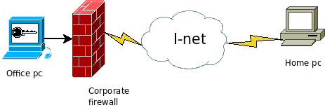
SSH Tunnels
Reverse SSH Tunnel
Initiate a connection from within a network to a remote location, allowing reverse traffic
Notes:
Reverse SSH images from toic.org

Slide 54
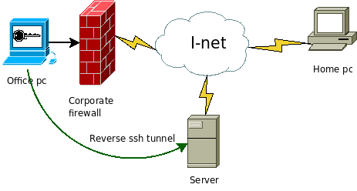
SSH Tunnels
Reverse SSH Tunnel
Initiate a connection from within a network to a remote location, allowing reverse traffic
Reverse SSH tunnel opened from office PC to outside server
Notes:
Reverse SSH images from toic.org

Slide 55
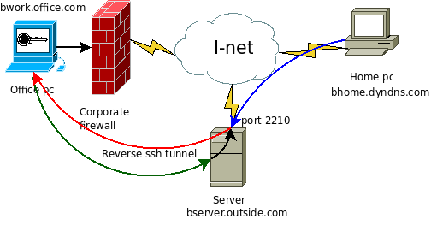
SSH Tunnels
Reverse SSH Tunnel
Initiate a connection from within a network to a remote location, allowing reverse traffic
Reverse SSH tunnel opened from office PC to outside server
Outside server now has encrypted path inside corporate firewall
Notes:
Reverse SSH images from toic.org

Slide 56
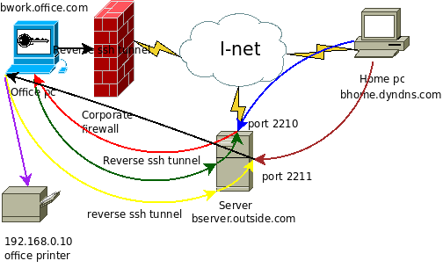
SSH Tunnels
Reverse SSH Tunnel
Initiate a connection from within a network to a remote location, allowing reverse traffic
Reverse SSH tunnel opened from office PC to outside server
Outside server now has encrypted path inside corporate firewall
Traffic can now be routed through the office pc to the internal network, bypassing firewall and security measures
Server bserver.outside.com is hiding true source of bhome.dyndns.com
Many corporate firewalls block outbound traffic for this reason!
Notes:
Reverse SSH images from toic.org

Slide 57
History of E-Mail
Various host-based email systems were set up to share files among users
Most only allowed for sharing of files among users on the same server
Many different systems with different features, often incompatible
LAN email systems developed to handle PC’s
Initially only allowed communication between users on the same server
Eventually allowed different servers to communicate, so long as they all used the same email system and proprietary protocol
Many different attempts at email network standards
SMTP became standard in mid 1990’s
Created standards for email addressing, formatting, and transmissions

Slide 58
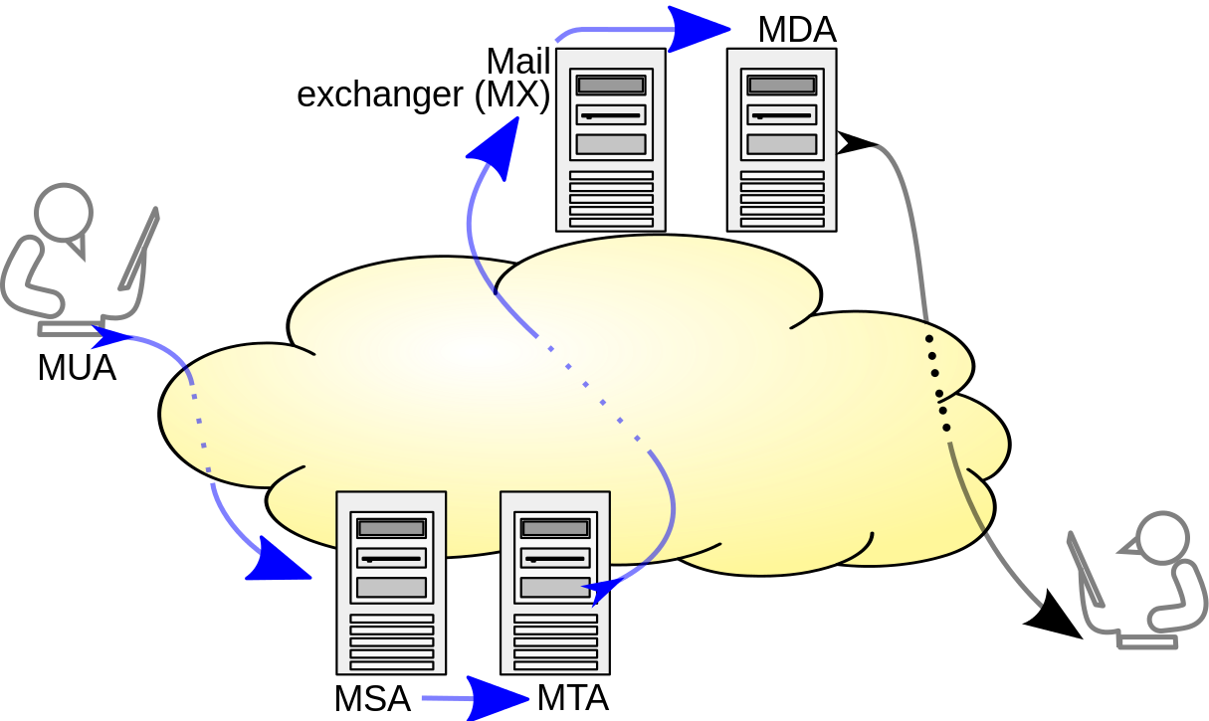
E-Mail System Terminology
MSA – Mail Submission Agent
Provides address resolution services
Determines appropriate server to send email to for specified email address
Looks up MX records for a domain
MTA – Mail Transfer Agent
Accepts E-Mail from clients and sends to another MTA for delivery
Indicated by MX DNS records
Sendmail, Postfix
MDA – Mail Delivery Agent
Delivers E-Mail from server to MUA (inbox)
Integrated with Sendmail, Postfix
MUA – Mail User Agent
E-Mail client
Outlook, pine, Gmail, SquirrelMail
Multiple functions
can be combined!
Notes:
By Ale2006-from-en - Own work, CC BY-SA 3.0, https://commons.wikimedia.org/w/index.php?curid=10583999
Blue arrows indicate SMTP

Slide 59
E-Mail System Terminology
Open E-Mail Relay
Allows for sending of E-Mail to an intermediate mail server, before the message is sent to its destination
May allow for anyone to send email as anyone to anyone else
Open relay’s will accept email for any domain and attempt to deliver
Should not be allowed on the Internet, can easily be abused for spamming
Typical E-Mail relay only allows authorized clients to connect
Masquerading
Replacing your actual host name with the email domain name
Ex: instead of smtp.gmail.com, just gmail.com
Spammers
Jerks who send unsolicited E-Mail to sell something or trick users

Slide 60
DNS for E-Mail
In order to send email to a user, the domain for that user needs an MX record
The MX record indicates which server is responsible for accepting email for a domain
MX records can be found using the “dig mx domainname.tld” command
The MX record itself also needs an A/AAAA record to resolve the IP address for the mail server
The MX record is proceeded by an integer indicating server priority
Delivery is attempted to servers with a lower priority number first, following servers attempted in sequence
Multiple servers can service a single domain name
Multiple MX records for a domain provides fault tolerance
A single mail server can service multiple domain names
A mail server may handle email for multiple domains

Slide 61
DNS for E-Mail
Example E-Mail DNS Records
First MX record indicates mail server spamblock.edinboro.edu
Priority is 5
IP address (A record) is 147.64.32.99
Second MX record indicates mail server spamblock2.edinboro.edu
Priority is 10
IP address (A record) is 147.64.32.98
edinboro.edu. 3600 IN MX 5 spamblock.edinboro.edu.
edinboro.edu. 3600 IN MX 10 spamblock2.edinboro.edu.
spamblock.edinboro.edu. 3600 IN A 147.64.32.99
spamblock2.edinboro.edu. 7200 IN A 147.64.32.98

Slide 62
E-Mail Protocols
Simple Mail Transfer Protocol (SMTP)
Used to send E-Mail messages
From user to mail server, or between mail transfer agents
Post Office Protocol 3 (POP3)
Used to retrieve E-Mail from a server
Traditionally all messages are downloaded to the client and removed from the server
New POP3 implementations will allow downloaded messages to remain on server
Internet Message Access Protocol (IMAP4)
Used to retrieve E-Mail from a server
E-Mail messages will remain on server
Server can be configured with folders for organization

Slide 63
E-Mail Ports
Simple Mail Transfer Protocol (SMTP)
Port 25: Legacy SMTP relaying port, currently mostly used for SMTP relaying between servers. Often blocked by ISP’s to prevent spam.
Port 465: Deprecated secure SMTP submission port, should no longer be used.
Port 587: Current formalized SMTP submission port. Can be used with encryption.
Additional ports are often used.
Post Office Protocol 3 (POP3)
Port 110: Default non-encrypted port
Port 995: Encrypted POP3 port
Internet Message Access Protocol (IMAP4)
Port 143: Default non-encrypted port
Port 993: Encrypted IMAP port

Slide 64
SMTP Commands and processes
Commands are processed by the SMTP server
E-Mail can be manually sent using some of the commands below
Command | Purpose
HELO | Identifies the domain sending the message
DATA | Indicates the body of the message
VRFY | Verifies the e-mail user
QUIT | Ends the SMTP session

Slide 65
SMTP Commands and processes
SMTP headers can be used to add descriptive information
Header | Description
MAIL FROM: | Identifies who is sending the message (required)
RCPT TO: | Identifies the recipient of the message (required)
RECEIVED: | Identifies the e-mail server that processed the message
DATE: | Indicates the date of the e-mail
FROM: | Shows the e-mail address as it is typically displayed in an e-mail client
SUBJECT: | Shows the subject of the e-mail message
TO: | Shows the recipient as it is typically displayed in an e-mail client
CC: | Sends copies of the message to a list of e-mail addresses
BCC: | Sends copies of the message to a list of e-mail addresses but does not display the e-mail addresses

Slide 66
SMTP Commands and processes
Sample SMTP Session (edinboro.edu):
[root@ecsc325-125 ~]$ telnet spamblock.edinboro.edu 25
Trying 147.64.32.99...
Connected to spamblock.edinboro.edu.
Escape character is '^]'.
220 barracuda.edinboro.edu ESMTP (8908a72cdf255605894d2e1a03ee284e)
HELO megastuff.biz
250 barracuda.edinboro.edu Hello ecsc325-125.cs.edinboro.edu [147.64.243.125], pleased to meet you
MAIL FROM: <jason@megastuff.biz>
250 Sender <jason@megastuff.biz> OK
RCPT TO: <jpatalon@edinboro.edu>
250 Recipient <jpatalon@edinboro.edu> OK
DATA
354 Start mail input; end with <CRLF>.<CRLF>
From: jason@megastuff.biz
To: jpatalon@edinboro.edu
Subject: test email
This is a test
.
250 Ok: queued as EFB4511EE001
quit
221 barracuda.edinboro.edu Goodbye ecsc325-125.cs.edinboro.edu, closing connection

Slide 67
SMTP Commands and processes
Sample SMTP Session (pennwest.edu):
[root@csci325-110 ~]# telnet pennwest-edu.mail.protection.outlook.com 25
Trying 52.101.41.6...
Connected to pennwest-edu.mail.protection.outlook.com.
Escape character is '^]'.
220 SJ1PEPF00001CE6.mail.protection.outlook.com Microsoft ESMTP MAIL Service ready at Sun, 16 Feb 2025 21:05:06 HELO megastuff.biz
250 SJ1PEPF00001CE6.mail.protection.outlook.com Hello [147.64.2.12]
MAIL FROM: <elon@megastuff.biz>
250 2.1.0 Sender OK
RCPT TO: <jpatalon@pennwest.edu>
250 2.1.5 Recipient OK
DATA
354 Start mail input; end with <CRLF>.<CRLF>
From: "President Elon Reeve Musk, Esq." <elon@tesla.gov>
To: <jpatalon@pennwest.edu>
Subject: test email
This is an Elon test for ecsc325...
.
250 2.6.0 <…> […] 8978 bytes in 2.971, 2.951 KB/sec Queued mail for delivery
quit
221 2.0.0 Service closing transmission channel

Slide 68
SMTP Commands and processes
Most SMTP servers will only accept E-Mail to or from users of that server
SMTP servers will often check the SPF record of the sender before accepting the message
SPF: Sender Policy Framework
SPF record indicates who is allowed to send email for a particular domain
SPF record can be found with the following commands:
dig TXT pennwest.edu OR dig SPF pennwest.edu
Example SPF record:
v=spf1 ip4:216.119.103.65 ~all
Indicates SPF version, IP address(es) allowed to send email for a domain, and how to handle failure
~all is a soft failure, message accepted but is marked as softfail
Useful for debugging or transitioning
-all would be a hard fail

Slide 69
POP3 Commands and processes
Post Office Protocol 3 (POP3) is used to download user E-Mail from a server
E-Mail messages are typically removed from the server after download
E-Mail clients (Outlook – MUA) can be configured to leave the messages on the server
POP3 is less complicated than IMAP4
After logging in to a POP3 E-Mail server, a user can:
List
Read
Download
Delete E-Mail

Slide 70
POP3 Commands and processes
Command | Description
USER username | Connects to POP3 server based on user name
PASS password | Enters the password for the user, as in PASS: Ax6yy
LIST | Displays the message number followed by the number of characters in the message
UIDL | Displays the unique ID for each message
RETR n | Replaces the n with a message number to retrieve that message
TOP n lines | Instead of retrieving the whole message, retrieves the number of lines designated by the lines parameter for message number n
DELE n | Deletes message number n from the server
QUIT | Ends the session

Slide 71
POP3 Commands and processes
Probably easier just to google it! – This specific example offline now…
Example originally from:
http://coewww.rutgers.edu/www1/linuxclass2010/lessons/Email/sec_6.php
telnet gateway.linux.class 110
Trying 192.168.2.240...
Connected to 192.168.2.240.
Escape character is '^]'.
+OK
USER mailtest
+OK
PASS Password
+OK
RETR 1
+OK
Return-Path:
X-Original-To: mailtest@gateway.linux.class
Delivered-To: mailtest@gateway.linux.class
Received: from node18.linux.class (node18 [192.168.2.38])
by gateway.linux.class (Postfix) with ESMTP id A291B2B15C
for ; Tue, 12 Apr 2005 22:24:53 -0400 (EDT)
Received: from me?here.com (unknown [192.168.2.250])
by node18.linux.class (Postfix) with SMTP id 4653B14112
for ; Tue, 12 Apr 2005 22:24:03 -0400 (EDT)
To: some_guru@somewhere.com
From: pp@pp.com
Subject: Forged e-mail
Message-Id: <20050413022403.4653B14112@node18.linux.class>
Date: Tue, 12 Apr 2005 22:24:03 -0400 (EDT)
Hey,
The "To:" and "From:" are non-existent, but you still get the e-mail.
bye, bye
.
DELE 1
+OK
QUIT

Slide 72
IMAP4 Commands and processes
Using IMAP4, E-Mail messages will remain on server
Requires more storage space on the server (most costly for server owners/operators)
Messages are flagged to keep track of status. Flags include:
\Recent
\Seen
\Answered
\Flagged
\Deleted
\Draft
Led to the Microsoft developing Messaging API (MAPI)
Used for Microsoft Exchange
Provides many functions similar to IMAP
Can be used for things besides email

Slide 73
IMAP4 Commands and processes
Command | Description
LOGIN username password | Log on to the server with your user name and password, which are unencrypted.
SELECT mailbox | Select a mailbox before you perform mail tasks. The default mailbox is called inbox. The response gives a summary of mailbox information.
FETCH message(s) item(s) | Retrieve messages. The message(s) parameter gives the message number. The item(s) parameter determines what part of the message is fetched—that is, individual header items or the body of the text.
STORE message(s) flags | Change the flags associated with a message. Typically, this command is used to mark messages to be deleted, undeleted, or identified as unread.
LOGOUT | End the IMAP4 session.

Slide 74
E-Mail Client Configuration
A typical E-Mail client will need the following configuration information:
SMTP server hostname or IP address for sending mail
Ex: smtp.hostname.com
POP3 or IMAP4 server hostname or IP address for retrieving mail
Ex: pop3.hostname.com
A valid E-Mail address account name
A valid password

Slide 75
Web-based E-Mail Clients
Web-based E-Mail clients allow users to send email directly from their web browser
SquirrelMail & Roundcube are web-based email services which can be freely installed on a mail server
Most current public E-Mail services use some kind of web-based email
Ex: Gmail, Yahoo mail, outlook.com
MS Exchange server can be used with Outlook Web Access (OWA)
Web-based email clients offer many benefits over traditional E-Mail clients:
No client configuration necessary, reducing user configuration support
No specialized software necessary to purchase, install, or maintain on clients
Users can retrieve E-Mail from any computer that can access the website
Additional features can be integrated, beyond standard POP3 or IMAP features

Slide 76
Virtual Hosts
http://ecsc325-1##.cs.edinboro.edu, http://147.64.243.1##
index.html: Hello ECSC-325 (Assignment 6)
index.php: PHP Info (Assignment 7)
http://ecsc325-1##.cs.edinboro.edu/phpmyadmin, http://147.64.243.1##/phpmyadmin
phyMyAdmin Website
http://1##.megastuff.biz/temp/temp.php
Temperature Graph Website
http://31##.megastuff.biz
index.html: Hello Megastuff Website
http://1##.ultrastuff.net
Ultra Modern Template Website
http://31##.ultrastuff.net
WordPress Website
http://##.megastuff.biz
TBD: Test page…
http://1##.megastuff.biz
TBD: Test page…
http://ecsc325-1##.cs.edinboro.edu/squirrelmail
TBD: Squirrelmail webmail
http://roundcube.##.megastuff.biz
TBD: Roundcube webmail
https://ecsc325-1##.cs.edinboro.edu/private
TBD: Private web site!
https://a13.##.megastuff.biz
TBD: Assignment 13 web site!
Replace the ## with your 2 digit number!!!

Slide 77
Virtual Machine Info
IP Address: 147.64.243.1##/23 (01-25)
Hostname: ecsc325-1##.cs.edinboro.edu (01-25)
Aliases:
31##.megastuff.biz, 1##.megastuff.biz, ##.megastuff.biz (01-25)
1##.ultrastuff.net, more?
Assignments 6 & 7 due next week!
Both available now!
Check script and document upload in D2L!
Accessing VM’s from off campus requires a connection to the CS VPN first, before opening a connection to your machine!
CS firewall prevents direct connections from other networks to our VM’s!
Once VPN is active: ssh user@ecsc325-1##.cs.edinboro.edu

Slide 78
Linux Commands
systemctl
systemctl list-unit-files
dig
nslookup
ssh
mkdir
wget
cd
ls
mv
pwd
vi
nano
dnf
mysql
chown
chmod
rm
rpm
telnet

Slide 79
Key Terms and Items
SSH tunnel
Reverse SSH tunnel
HTTP
Apache
Ports
E-Mail
MTA
MSA
MUA
MUA
Open E-Mail relay
Masquerading
Spammers
MX records
SMTP
POP3
IMAP4
RFC

Slide 80
For Next Week
“Many of life’s failures are men who did not realize how close they were to success when they gave up”
Thomas Edison
Textbook:
Chapter 16 – DNS
Chapter 18 – Apache
Chapter 19 – SMTP
Chapter 20 – POP/IMAP
Next week topics
E-Mail Services, File Transfers
Continuing work with VM’s
Assignment 5 was due this week!
Assignment 6 & 7 due next week.
Assignment 8 available? - due in 2 weeks?
Just because all tests say OK, doesn’t mean everything is working properly!

